Slide 1
Building a Shopping Mall in Mumbai, India
By
Shishir Pawar

Slide 2
Business Problem
The objective of this capstone project is to analyse and select the best locations in the city of Mumbai, India to open a new shopping mall. Using data science methodology and machine
learning techniques like clustering, this project aims to provide solutions to answer the business
question: In the city of Kuala Lumpur, Malaysia, if a property developer is looking to open a new
shopping mall, where would you recommend that they open it?

Slide 3
Data
To solve the problem, we will need the following data:
List of neighbourhoods in Mumbai. This defines the scope of this project which is confined to the city of Mumbai, the capital city of the India
Latitude and longitude coordinates of those neighbourhoods. This is required in order to plot the map and also to get the venue data.
Venue data, particularly data related to shopping malls. We will use this Wikipedia page (https://en.wikipedia.org/wiki/Category:Suburbs_of_Mumbai) contains a list of neighbourhoods in Mumbai, with a total of 42 neighbourhoods. We will use web scraping techniques to extract the data.
orm clustering on the neighbourhoods.

Slide 4
Methodology
Web scraping Wikipedia page for neighbourhoods list
• Get latitude and longitude coordinates using Geocoder
• Use Foursquare API to get venue data
• Group data by neighbourhood and taking the mean of the frequency of
occurrence of each venue category
• Filter venue category by Shopping Mall • Perform clustering on the data by using k-means clustering
• Visualize the clusters in a map using Folium

Slide 5
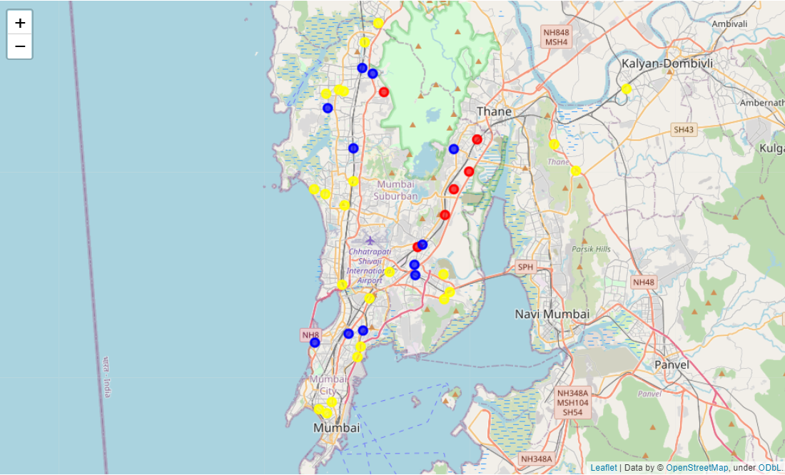
Result
Categorized the neighbourhoods
into 3 clusters :
Cluster 0 (red):Neighbourhoods with low number to no existence of shopping malls
Cluster 1 (blue) : Neighbourhoods with high concentration of shopping malls
Cluster 2 (yellow) : Neighbourhoods with moderate number of shopping malls

Slide 6
Discussion
Most of the shopping malls are concentrated in the lower and western area of the city
Highest number in cluster 1 and moderate number in cluster 2
Cluster 0 has very low number to no shopping mall in the neighbourhoods

Slide 7
Recommendations
Open new shopping malls in neighbourhoods in cluster 0 with little to no competition
Can also open in neighbourhoods in cluster 2 with moderate competition if have unique selling propositions to stand out from the competition
•Avoid neighbourhoods in cluster 1, already high concentration of shopping malls and intense competition

Slide 8
Conclusion
Answer to business question:
The neighbourhoods in cluster 1 are the most preferred locations to open a new shopping mall.
Findings of this project will help the relevant stakeholders to capitalize on the opportunities on high potential locations while avoiding overcrowded areas in their decisions to open a new shopping mall

Slide 9
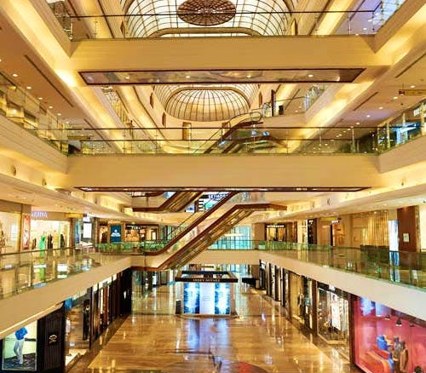
Thanks!

